Slide 1
Sprint Review: SVOT & Renewals
Sprint 6
23 June – 11 July

Slide 2





Sprint Overview
Sprint Numbers
Sprint Links
Key Dates
Weeks
3
Sprint work Items Delivered
Sprint 6 SIT Testing
14 Jul – 18 Jul
Work Items Delivered
28
Work Items To Still Test
Sprint 6 UAT Testing
21 Jul – 01 Aug
UAT Items Addressed
14
Update ”Grainger Testing” to “Yes” to confirm the work item has delivered the functionality detailed in the Acceptance Criteria
Story Points Completed
72
Dashboard Overview
Release 2 Go Live
01 Sep

Slide 3
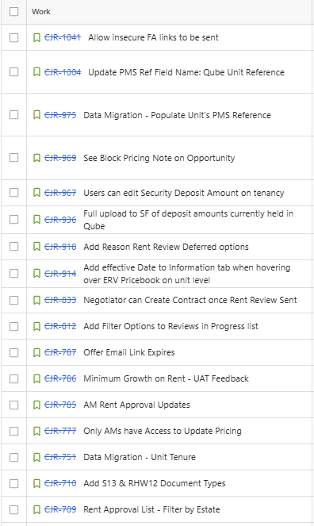
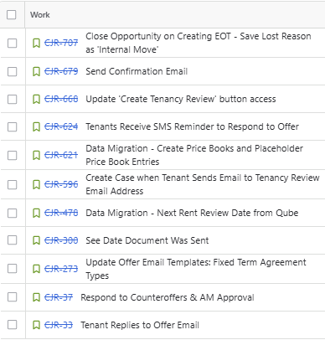
Work Items Delivered

Slide 4
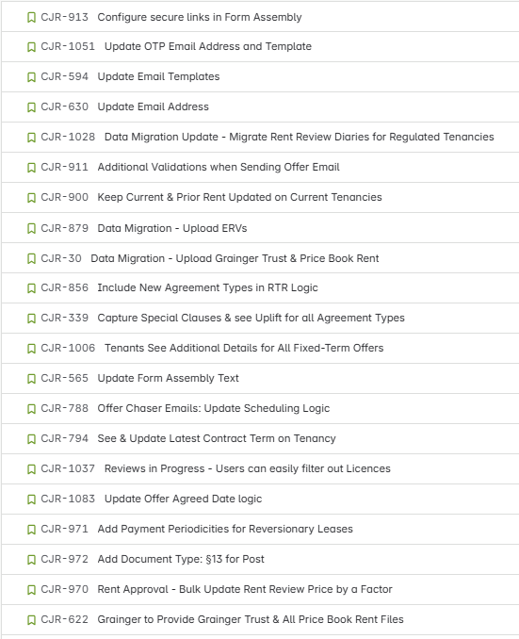
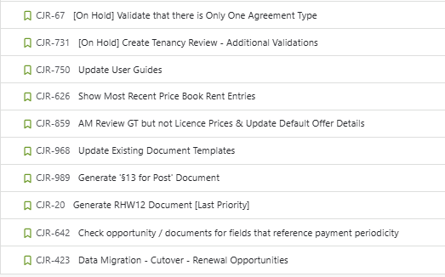
Work Items Planned for Next Sprint

Slide 5
General Items
Items Carried over to next Sprint | Reasons
None
Risk | Contributing factors | Impact | Decisions taken
None
Issue | Contributing factors | Impact | Decisions taken
None
Decision | Description | Date

Slide 6

Thank You

